Slide 1

Uploading large local files to GitHub repository

Slide 2
Download and Install Git
Go to https://git-scm.com/downloads
Select your operating system (macOS, Windows, or Linux/Unix)
Follow the instructions provided for downloading on your operating system

Slide 3
Download and Install GitLFS
Go to https://git-lfs.github.com/
Confirm the download is for your operating system (macOS, Windows, or Linux/Unix) and click the “Download” button

Slide 4
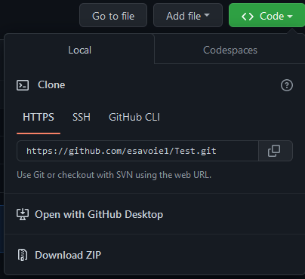
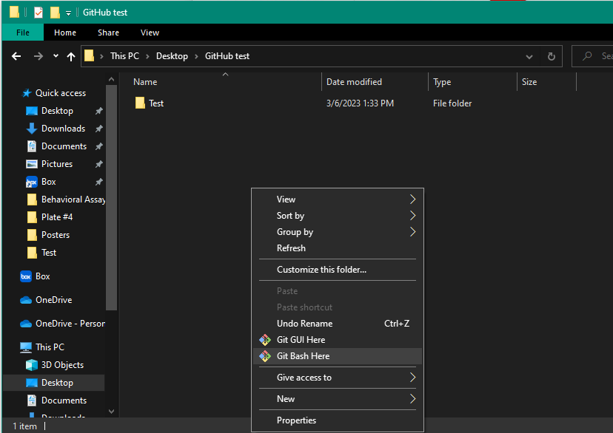
Clone your GitHub repository locally
Go to your GitHub repository
Click on the green “Code” button
Copy the HTTPS link
Create a new folder on your machine where you want your cloned repository to be
Right click the background of the new folder and click “Git Bash Here”
Run the following code:
git clone link you copied
i.e., git clone https://github.com/esavoie1/Test.git
Close the bash terminal

Slide 5
Uploading files
Copy the file you want to upload to the desired destination in your cloned repository
Go into your cloned repository
Right-click the background and select “Git Bash Here”
To make sure you are logged into GitHub on the bash terminal run:
git config --global user.email “your account email”
git config --global user.name “your account username”
A window will pop up for your credentials if you’re not logged in already. Enter them.
Running GitLFS
git lfs install (this only needs to be done once per account)
git lfs track “*.fileextension”
i.e., git lfs track “*.csv”
git add filename.fileextension
i.e., git add LionfishMaster.csv

Slide 6
Uploading files continued
Running GitLFS continued
git commit –m “add filename.fileextension”
i.e., git commit –m “add LionfishMaster.csv”
git pull
This command will make sure that you have the most recent version of your repository on your local branch. ALWAYS RUN THIS BEFORE YOU GO TO THE NEXT COMMAND!
git push origin main
A progress tracker will appear on the bash terminal
Once it’s done, you should see the recently uploaded files on your GitHub repository

